Slide 1
SENTINEL FALL
Hackster.io Hardware Board Design Competition, Seeking Passionate Teammates

Slide 2
2min Pitch for Hackster.io: Seeking Passionate Teammates
Hi everyone,
I’m excited to announce that my idea is competing in the global “HW Board Design Competition” by Hackster.io—the world’s largest network for hardware and software developers with 2M+ members. Out of 300 participants worldwide, I’ve already been awarded free hardware, and now we’re targeting one of the 7 awards in the category that requires using the nRF54L15 SoC. With only 1 other competitor in this category, our odds are 50%. The deadline is May 7.
Our team of 3 (with a hardware designer, a PCB designer, and a 3D casing designer) is incomplete. I’m looking for 2 more embedded developers to complete a team of 5, to help integrate the code and flash the board . We have sample code ready for GSM, fall sensors, LED, buzzer, PIR, and WiFi functionalities. The only missing piece is the BLE alerts using the nRF SoC.
The estimated time commitment is around 30-45 hours maximum (with a minimum of about 10 hours, depending on your proficiency—see the code links for details).
What’s in it for you?
• Boost your resume with recognition from the largest DIY electronics community—this work could be your gateway to companies like Apple, Meta, NVIDIA.
• Win a share of a $1,600 award (if we win, we’ll split it).
• Work on cutting-edge hardware with no out-of-pocket costs—PCB manufacturing is sponsored, and I’m covering all required sensors, development boards, etc.
If you’re ready and serious about completing this project by joining a winning team, or if you have any questions, let’s talk!

Slide 3
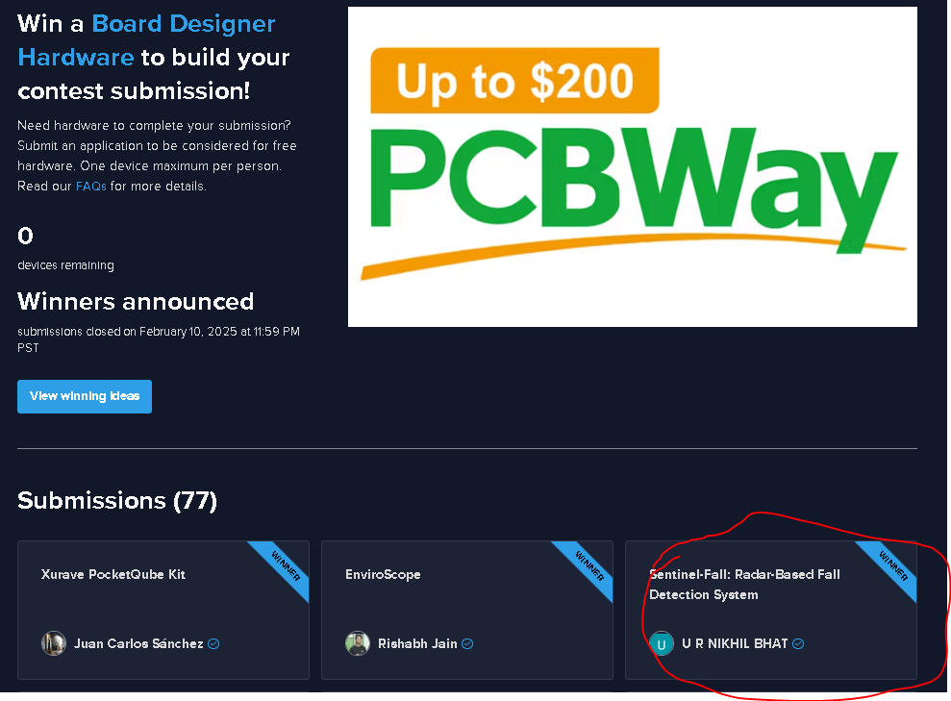
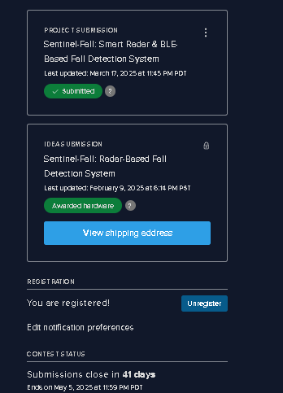
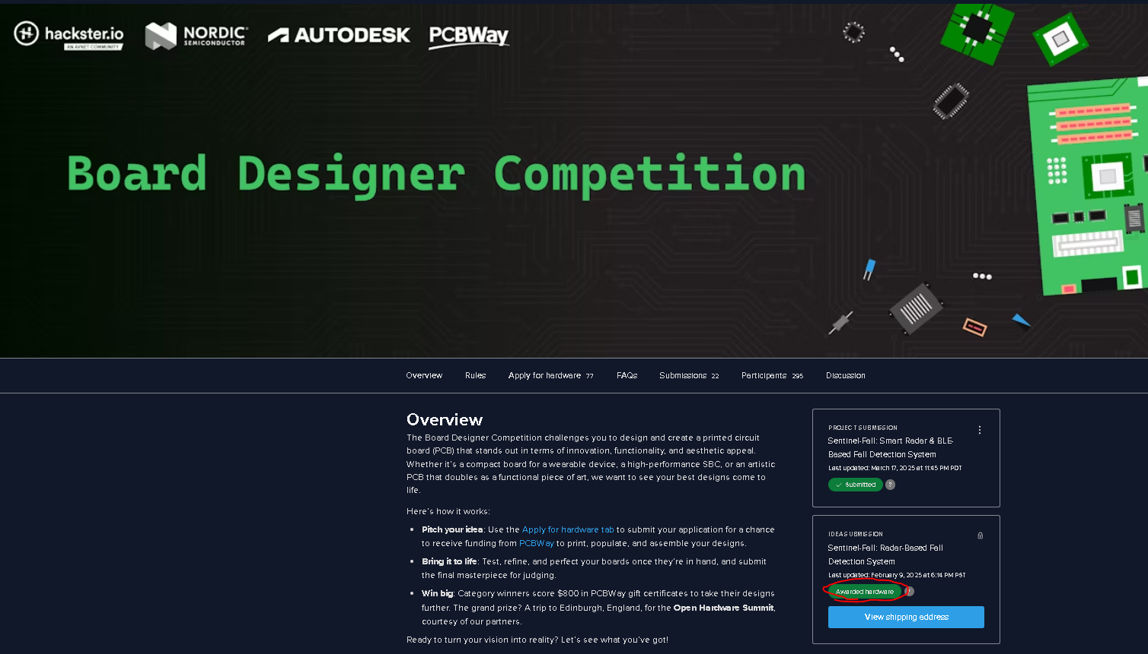

Slide 4
CONTEST LINKS
LINK: https://www.hackster.io/contests/board-designer/
RULES: https://www.hackster.io/contests/board-designer/rules#challengeNav
APPLICANTS: https://www.hackster.io/contests/board-designer/hardware_applications#challengeNav

Slide 5
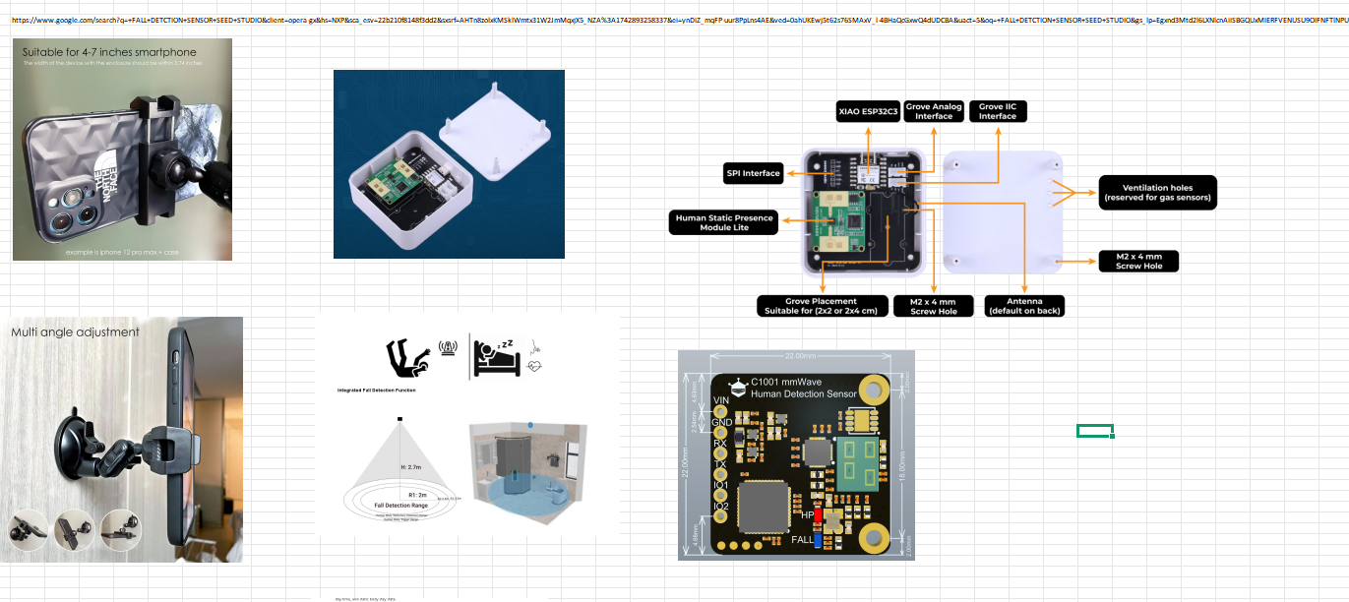
PRODUCT DEMO / IDEA
VIDEO LINK (THIS Inspired my ELEDERLY CARE idea): Fall Detection using Seeed 24GHz Radar V3 mp4 – YouTube .
VIDEO USING OUR SENSOR: https://www.youtube.com/watch?v=TL6rvUwu5pM&t=21s
PRODUCT VISZULIZATION: SQ CASING HOUSING an IOT MOTHER BAORD+FALL SENSOR which will be mounted ON A PHONE HOLDER AT AN ANGLE.

Slide 6
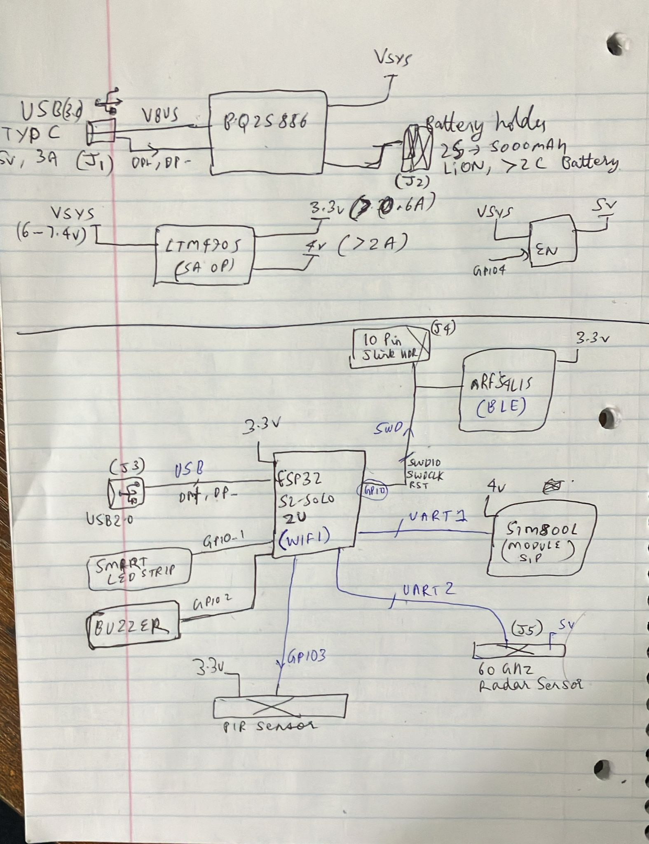
BLOCK DIAGRAM
This ESP32-based product is placed in a bathroom. When an elderly person enters, the PIR sensor triggers the radar sensor. If a fall is detected, the ESP32 sends Wi-Fi and BLE alerts via an NRF SoC and places a call if there’s no response within a minute. It also activates buzzers and an LED to alert nearby people. Powered by a Li-ion battery with an integrated charger circuit

Slide 7
PROJECT (SENTINEL FALL V1) LINKS
HACKSTER IO IDEA : https://www.hackster.io/nikhilbhatprofessionemail24/sentinel-fall-smart-radar-ble-based-fall-detection-system-265fd4
Drive LINK: https://drive.google.com/drive/folders/1og0-cyNMdtY2meslyzxeJi6veOh5vGKH?usp=sharing
SAMPLE CODE LINK: https://docs.google.com/spreadsheets/d/17cK6DskqsPV1TLppXEbN7NqS_tU-YJlg/edit?usp=sharing&ouid=116971944387178689090&rtpof=true&sd=true
MAJOR BOM LINK: https://docs.google.com/spreadsheets/d/18PLSK3BQoe9BZd1GB8mjw70U6o3VyVx7/edit?usp=sharing&ouid=116971944387178689090&rtpof=true&sd=true
DESIGN DOC: https://docs.google.com/spreadsheets/d/18UWA6evSdDg86P9OvnSrfuiGEn18Aahs/edit?usp=sharing&ouid=116971944387178689090&rtpof=true&sd=true
SCHEMTIC LINK: https://drive.google.com/file/d/13JjHhsZBS-6TjM8PlndOX_v71Agv2r9u/view?usp=sharing

Slide 8
Judging criteria
Innovation and Originality (20 points)
Technical Excellence (20 points)
Functionality and Performance (20 points)
Aesthetics and Design Presentation (20 points)
Documentation and Presentation (20 points)
Bonus: Autodesk Fusion use (40 points)

Slide 9
WHY I THINK WE CAN WIN THIS COMPETITON
"The Kitchen Sink Award" requires the PCB to have a fully functioning nRF54L15 SoC.
Currently, only two projects in the contest are using this SoC (see projects here).
Our direct competition (OrientA Zero) is relatively simple and straightforward.
If we successfully integrate and demonstrate our design, our project will be significantly more advanced, feature-rich, and compelling in comparison.
Simply put, if we can get ours working, we will not only surpass the competition—we will clearly stand out and win.

Slide 10
PROEJCT PLAN
Date | Milestone & Action Items
Now – Apr 2 | • Review and finalize board design.• Submit Gerber files to PCBWay.• Begin prototyping with ordered development board and sensor modules.
APRIL 2- 13 | • Finalize project flowchart.• Complete prototyping and verification of all modules (excluding nRF functionality).
APRIL 13- 20 | • PCB arrives; assemble components.• 3D print casing.• Test board thoroughly—verify SoC functionalities via UART and LED indicators.
APRIL 20 -25 | • Complete final product assembly.• Install device at intended location.• Record demonstration video highlighting key functionalities.
APRIL 25- MAY 5 | • Complete detailed project documentation.• Submit final project to Hackster.io competition.
May-23 | Competition Winners Announced!

Slide 11
Contact INFO:
PHONE NO: +1 7202183649
EMAIL: nikhilbhatprofessionemail24@gmail.com
Please respond within the next 48 hours if interested.

